Slide 1
UIPath Project
By James Harper

Slide 2
Project Scope
User registration
Content Aggregation
Report Collation
Detailed Process Description
Information Gathering
Version Control
Outside Resources

Slide 3
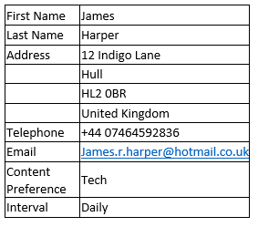
User Registration
Subject Tag Line
Unique ID
Parsing HTML Table
Moving Email

Slide 4
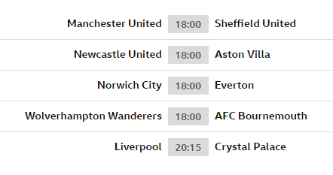
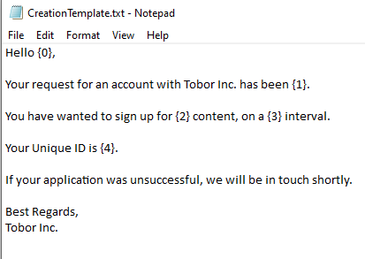
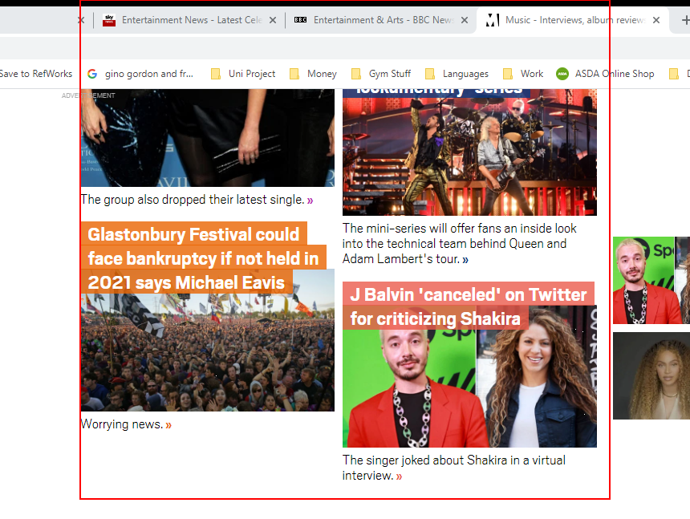
Content Aggregation
Tabular Data
Guaranteed Different Data
Formatting
Issues

Slide 5
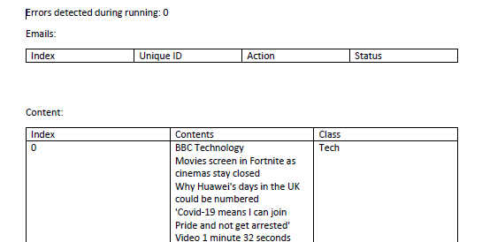
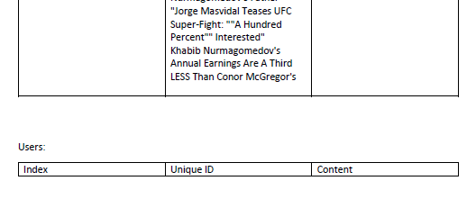
Report Collation
Time Saved
Easy To Read
User Tracking
Error Upkeep

Slide 6
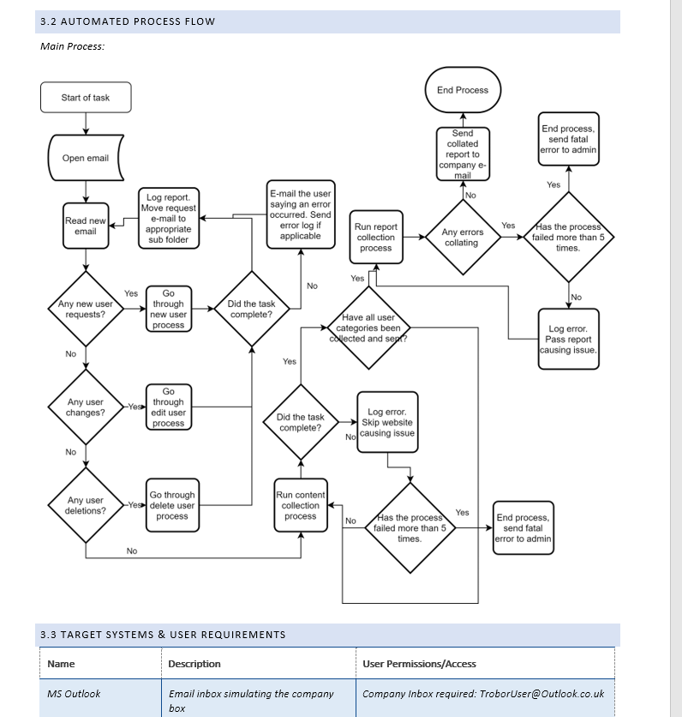
Detailed Process Description (DPD)
Overarching Document
Automation Details
Automation Usage
Pre/Post Automation

Slide 7
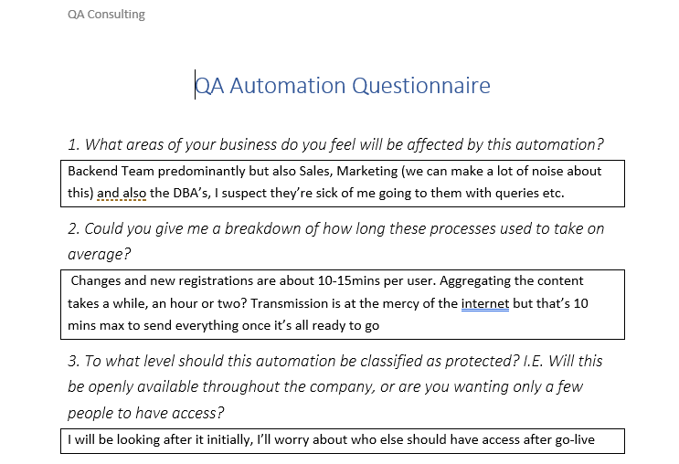
Information Gathering
Project Specification
Specifics
Lost In Translation
Form Of Communication

Slide 8
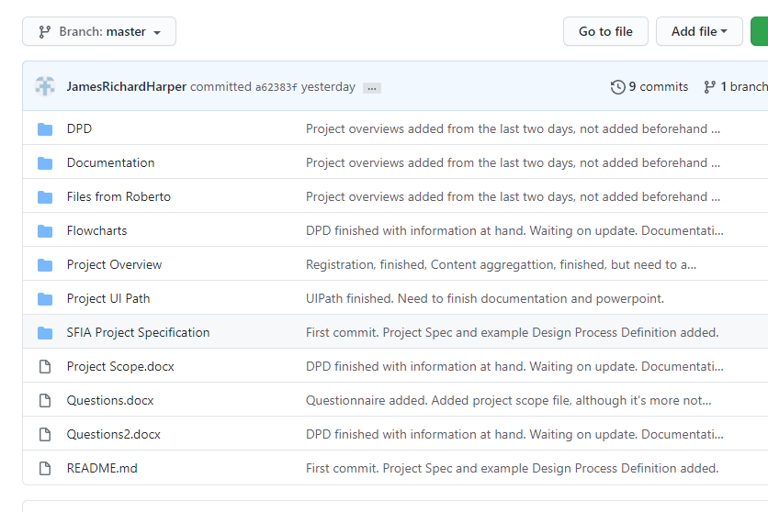
Version Control
File Backups
Testing Software
Company Wide Deployment

Slide 9
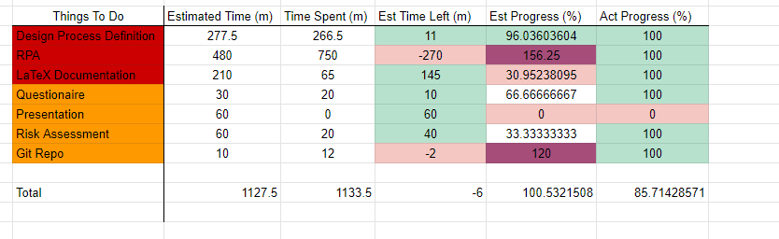
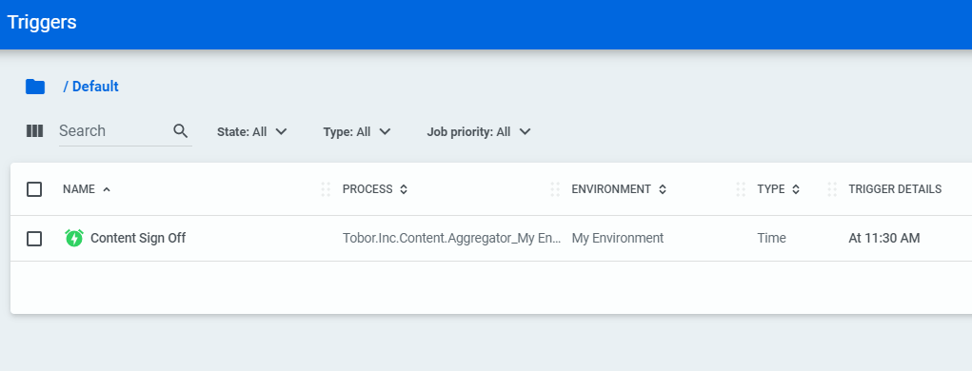
Outside Resources
Management
Where You’re At
Error Keeping
Daily Automating
Security

Slide 10
Thanks For Listening!
Is There Any Questions?

